Slide 1

What’s Next in Soccer?
Will 2019-20 seasons continue? What’s next in store for international play? Get filled in.

Slide 2



Will the English Premier League resume soon?
According to Sports Illustrated, the Premier League is hoping its clubs can resume training by May 18 at this time.
This would allow a return to games on June 8, meaning the season could be played out.
If the season cannot be finished, it will be interesting to see how the 2019-2020 season will be written in history, as Liverpool was running away with a 25 point lead.

Slide 3


What about other leagues?
Bundesliga said a while back they were hoping to resume play, or training at least, by May 9. Germany’s government, however, pushed their top soccer league’s season back by at least a week.
Like EPL, we could easily see Bundesliga not competing until June because the outbreak of COVID-19 is unpredictable as we’ve seen it.
The Spanish government is also controlling the destinies of Spanish clubs, as their play will be put on hold for a while.

Slide 4
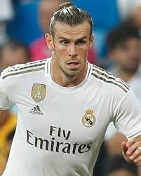
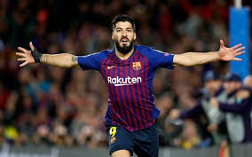
How is La Liga affected?
Officials are now saying that Spain’s best league definitely won’t be back before “the summer” (SI)
Spain’s government giving the description of a season is very vague, and could imply we don’t see professional soccer in Spain until mid-June or maybe even July.
Barcelona currently has a two point lead on Barcelona, so many fans want to see the 2019-20 season played out.

Slide 5

Will Serie A continue?
Although Italy was affected greatly by the coronavirus disease, Serie A teams have currently been given the green light by their government to resume training on May 18.
There are 12 match days remaining, and Italy’s best professional soccer league plans to resume matches at the beginning of June, but Italy’s sports minister is not optimistic that a full return can happen (SI).

Slide 6

TRT World Video
This clip, which is a little over four minutes, from TRT World describes how the COVID-19 outbreak is affecting the entire sports industry.

Slide 7

The End of the Semester :(
Unfortunately, the end of the spring semester at Marian means I will not be posting content as frequently as I have been.
I still plan to utilize this blog and WordPress in the future, as I believe it helps my creative process greatly.
Thanks to anyone who checked out the Strikers Professional Soccer Blog! Views are always very appreciated.

Slide 8
Acknowledgements
https://www.si.com/soccer/2020/04/28/europe-leagues-uefa-plan-return-dates-coronavirus-matches
https://www.youtube.com/watch?v=Q1si30RV11c

